Slide 1
2019 Reproducibility Challenge
MikGroup: Ke Wang, Suma Anand,
Volkert Roeloffs, Ekin Karasan, Miki Lustig
University of California, Berkeley

Slide 2
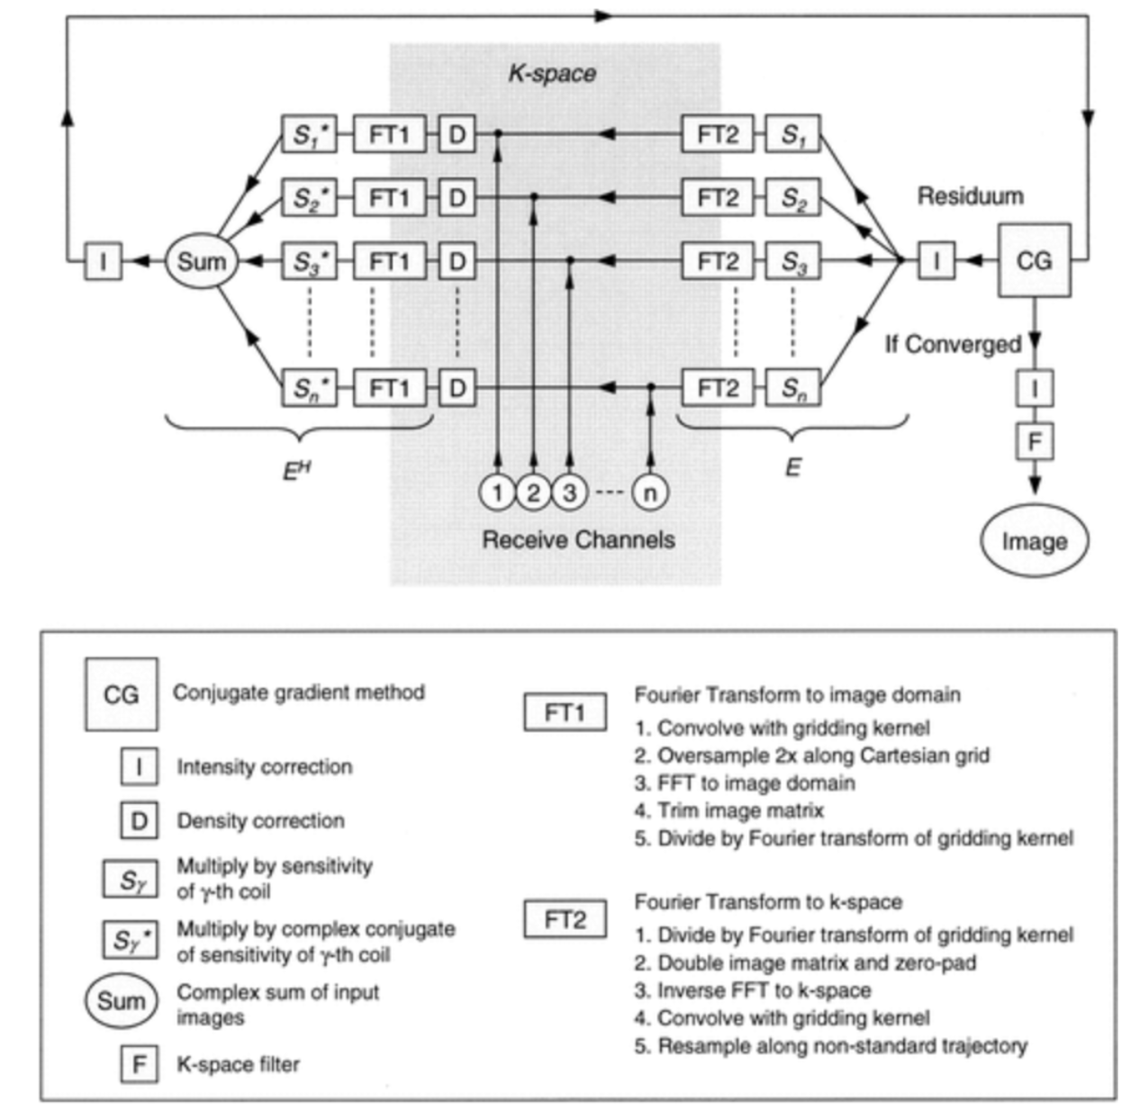
Advances in sensitivity encoding with arbitrary k-space trajectories
Implementation powered by sigpy @ Frank Ong

Slide 3
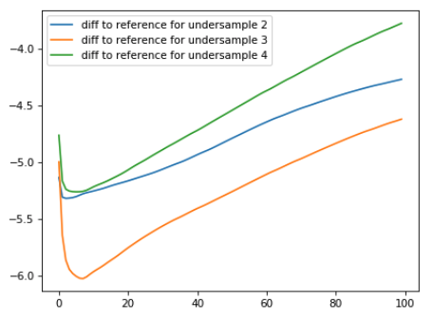
Advances in sensitivity encoding with arbitrary k-space trajectories
Figure 4. True image error

Slide 4
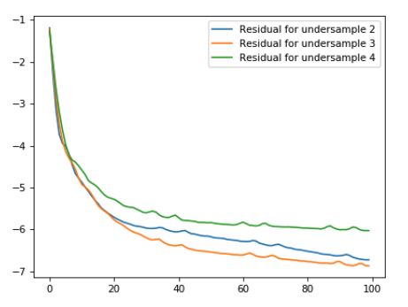
Advances in sensitivity encoding with arbitrary k-space trajectories
Figure 4. Criterion: residual

Slide 5
Advances in sensitivity encoding with arbitrary k-space trajectories
Reconstruction results of the brain images

Slide 6
Advances in sensitivity encoding with arbitrary k-space trajectories

Slide 7
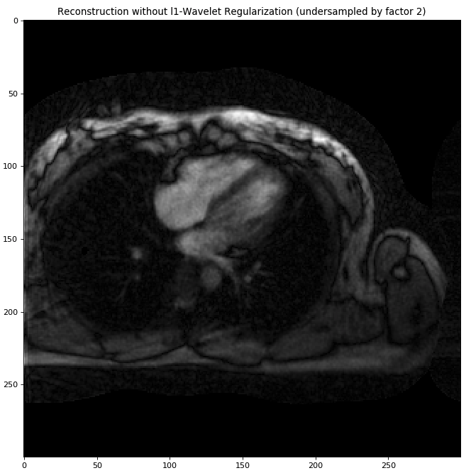
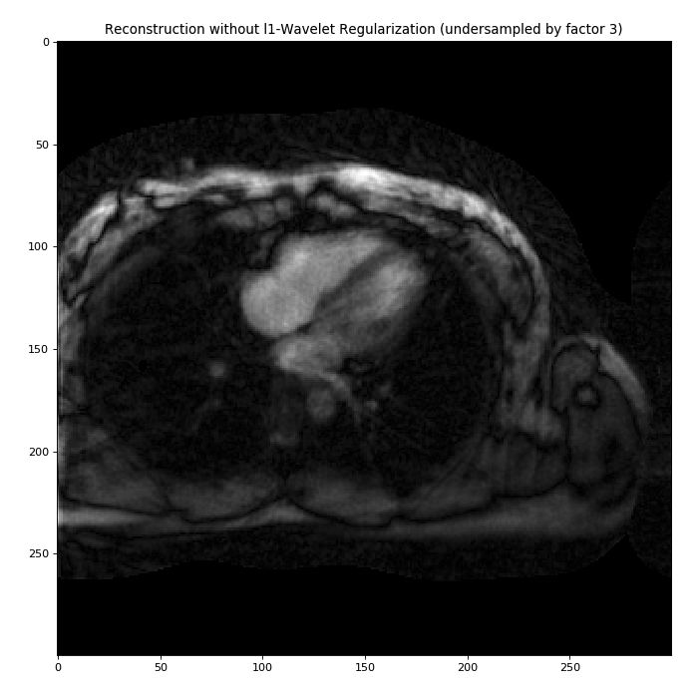
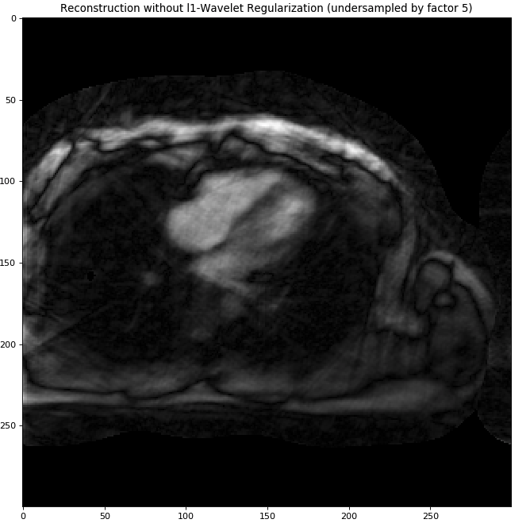
Advances in sensitivity encoding with arbitrary k-space trajectories
Reconstruction results of the cardiac images
R = 2 (28)
R =3 (18)
R =5 (11)

